Slide 1
Identifying and Reducing Customer Churn in Banking
Megan Cusey Spring 2020

Slide 2
Phase I: Business Understanding
Brief Overview: AWP Bank has requested MLC Consulting services to conduct a thorough analysis that predicts customers who are more likely to churn and identify the strongest predictors of churn. Once this information has been gathered, actionable insights will be drawn from this information on how to increase customer retention among those who the model has flagged as a likely churner.
Next Steps: The next few slides contain details on a first prototype of a series of models run on the data provided by AWP Bank. As result, we can gain additional information about the nature of the data and potential candidate models.

Slide 3
Prototype I – Auto Modeler

Slide 4
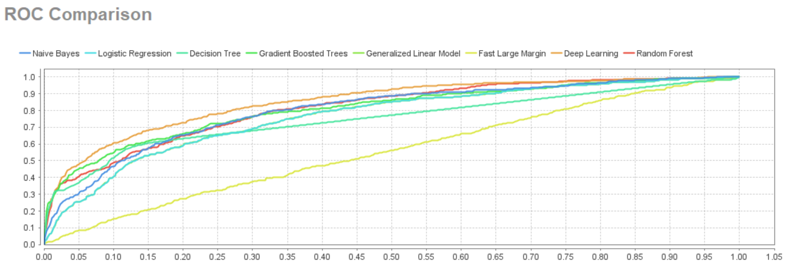
The above ROC curve represents a general overview of each candidate model’s performance. The clear loser here is the Fast Large
Margin model. Its results are not any better then guessing. The other models perform similarly, though Deep Learning, Random
Forest, Gradient Boosting Trees, and Naïve Bayes all have AUC (area under the curve) metrics above .8. This indicates that these
models optimizes a balance between specificity and sensitivity.

Slide 5
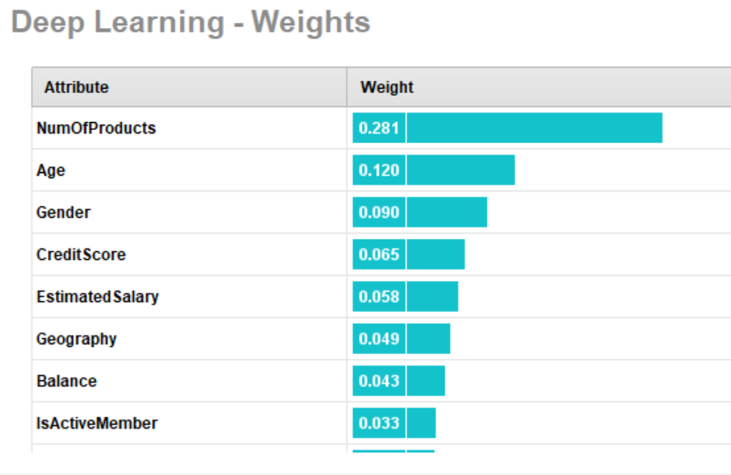
The weights provided by the deep learning algorithm advises us what some
of the stronger predictor variables might be. For example, it appears that
NumOfProducts is the most significant variable according to this deep
learning model.

Slide 6
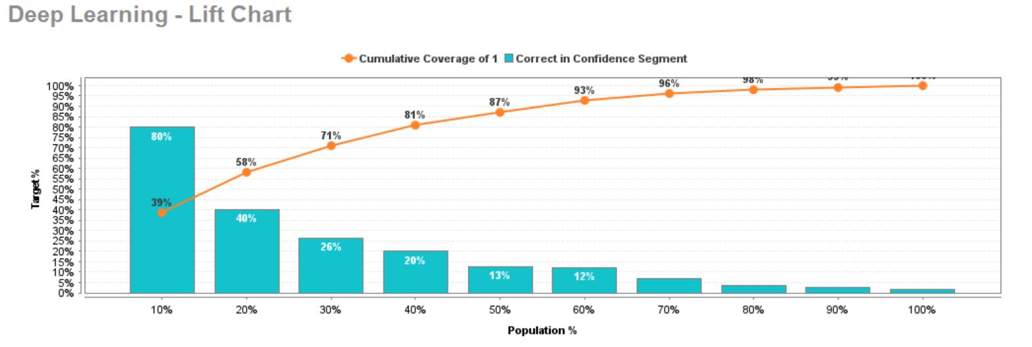
This lift curve tells us that if we were to sort the probability of a customer churning produced by the
model in descending order, the first 10% of the rows would contain 39% of the total predicted churners
with an 80% overall accuracy rate. From there, you see that the accuracy decreases and the percent of
the predicted positive churners increases more slowly it reaches 100% of the total population.

Slide 7
Are the top candidate models enough?
We obtained an AUC over .8 and received the information about weights which was a part of our overall objective. Is this enough to call our project complete?
The answer is no. The overall goal is to create a model that will generalize the patterns of the data well enough to be applied to new data. The following key points are steps we need to complete to ensure we are not just creating a model to memorize the training data.
First, Deep Learning was considered the top machine learning method. While it is possible that Deep Learning might provide the top results, it is a complex model. Complex models tend to over fit the data and is more expensive to use in production. We should attempt to find a simpler model to do the work for us, even if it means looking into our features more thoroughly to find improvements in predictive power.
Second, we haven’t investigated our data at all at this point. Multicollinearity may occur between independent variables which makes it harder for us to rely on the results regarding variable weights.
Third, we may be able to improve the model even more once reviewing the quality of the data, accounting for missing values, and removing outliers.

Slide 8
Data Access & Understanding

Slide 9
Data Access & Understanding
The following section will describe the data set provided by AWP Bank and the features provided. We will review the nature of each column, the distribution, and search for missing values.

Slide 10
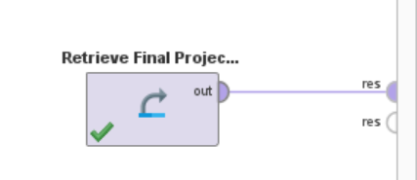
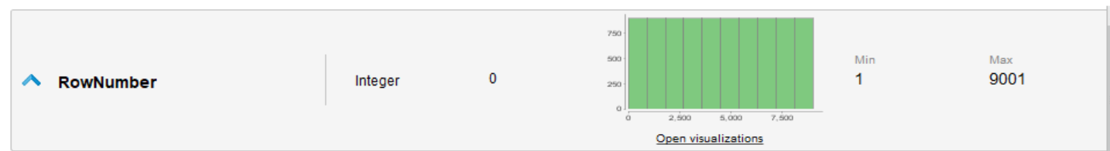
The following block in RapidMiner was used to load in the data and output
the data set for analysis.
Row Number – Appears to be an auto incremented ID column. It does not have any missing values. Since it’s a simple ID column on the table, it doesn’t provide us any useful information and can be removed from the modeling process.

Slide 11
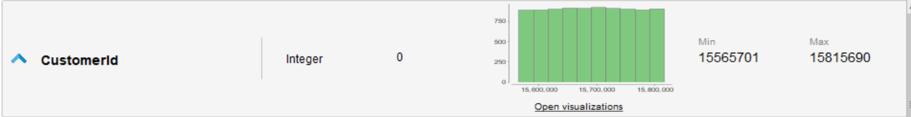
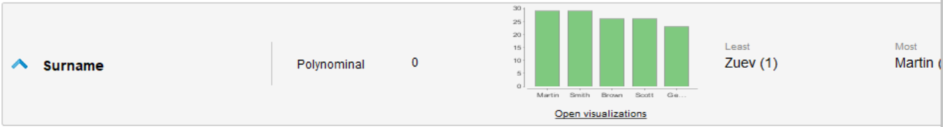
CustomerID also appears to be just another ID column. Sometimes, the ID column can represent more of a categorical variable, representing an entity. While this is true in this case as well, the data set seems to have the level of granularity of one row per customer. Therefore, I believe that this column will not be helpful in predicting churn. This column will be removed from the modeling process.
Surname is simply the last name of the clients for customers. I would like to exclude this from analysis due to the information being irrelevant. Even if this feature was statistically significant, it’d likely be a fluke due to more common last names versus other more unique last names.

Slide 12
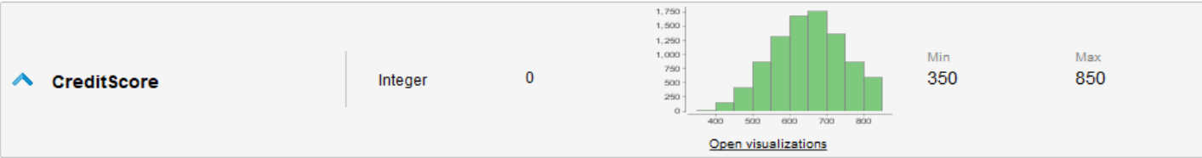
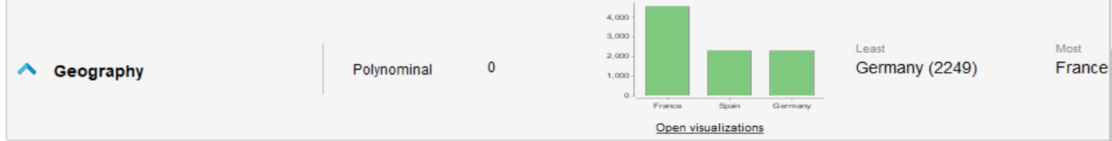
Credit Score is a great feature for this dataset. It has a relatively normal distribution. The min and max for the data makes since as a credit score can range from 300 to 850.
The Geography column provides information on which country the branch the member does
business in. There are no missing values and each row has a correct indication for one of the
countries: Germany, Spain, or France.

Slide 13
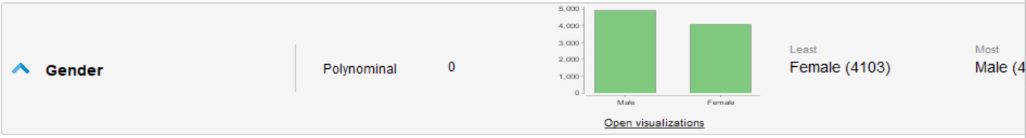
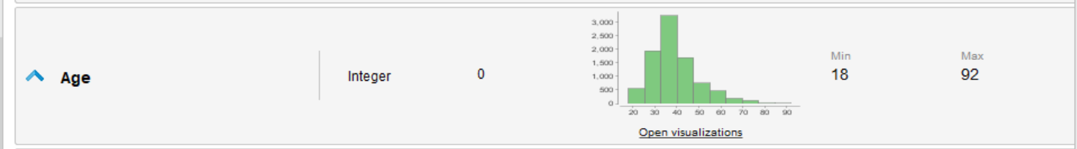
Gender has no missing values and all observations fall into a female/male category. While the distribution isn’t perfectly even, they are close.
Age does not have any missing values, the distribution is slightly skewed, but a range of ages from 18-92 is expected. This indicates to me that all values are reasonable for customers of a bank.

Slide 14
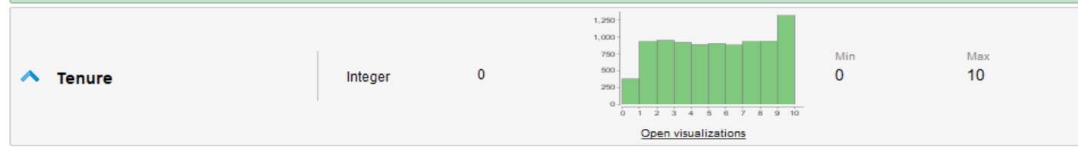
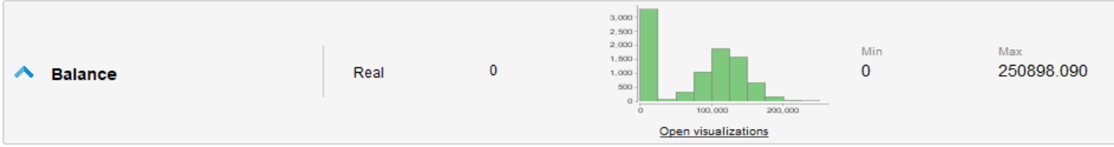
Tenure has an interesting distribution where the maximum of the dataset is 10 and the most frequent
occurrence is the maximum. I assume tenure means the length the customer has been at AWP Bank.
Certainly, I would assume that there are some customers that have been a client longer than 10 years. I
would assume that the frequency gets lower as the number of years increase. Perhaps this dataset capped
the number of years at 10. I would like to still include this feature but might manipulate it later.
Balance has an expected distribution with no missing values. Most customers have a balance close
to zero while others have some in $50,000 - $250,000 range that (if you disregard the $0 balance),
has a normal distribution.

Slide 15
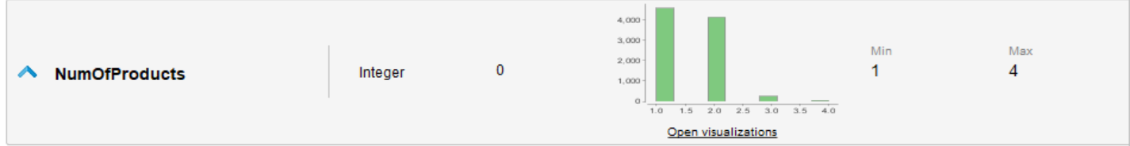
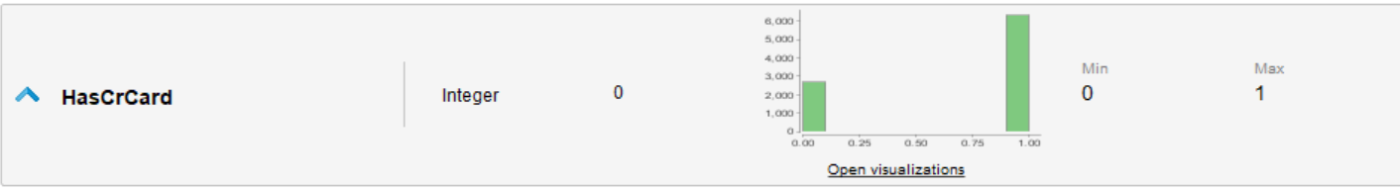
NumOfProducts has no missing values and ranges from 1-4. NumOfProducts describes how many bank
related products or accounts the customer has.
HasCrCard describes if the customer has a credit card or not. This feature is a binary feature, therefor;
needs updated from the data type of “integer” to “binomial”. Otherwise, there is no missing values
and each data point is either a 0 or 1.

Slide 16
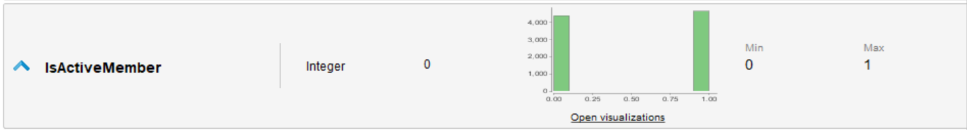
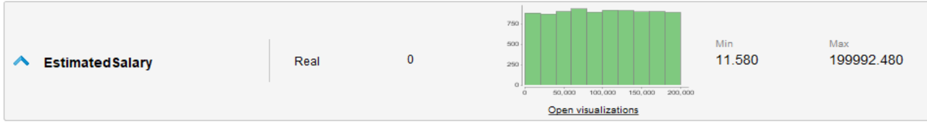
IsActiveMember describes the activity of a customer. This feature is a binary feature, therefor;
needs updated from the data type of “integer” to “binomial”. Otherwise, there is no missing values
and each data point is either a 0 or 1.
EstimatedSalary represents the approximate salary a customer earns. There are no missing values and
the distribution appears pretty even over the dataset.

Slide 17
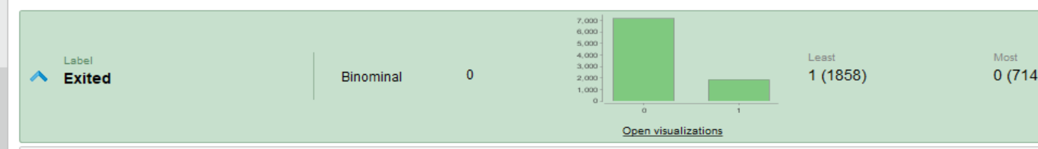
About the Target: Exited
Exited is a binomial feature that represents if a customer churned or not.
There are no missing values.
There is a class imbalance as the number of false churners is significantly more frequent than true churners, which is expected.

Slide 18
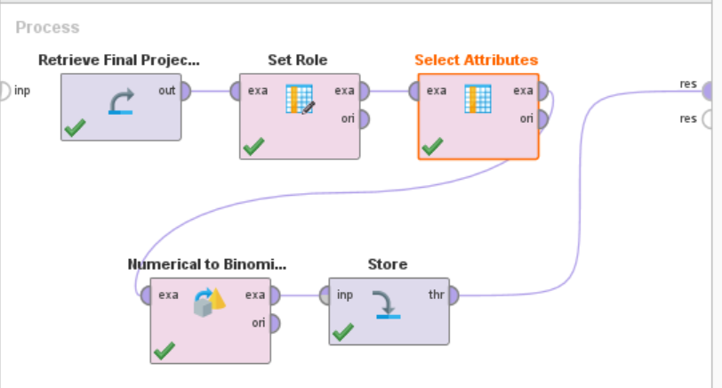
The following steps are performed in RapidMiner as a result of the Data Access & Understanding phase:
1. Retrieve the final project dataset
2. Label Exited as the target.
3. Select all attributes (exclude those mentioned in the analysis)
4. Convert HasCrCard and IsActiveMember to binomials.
5. Store this version of the data set to use in Auto Model

Slide 19
Data Preparation

Slide 20
When attempting to identify outliers using RapidMiner, I ran into a computational RAM limitation that would not allow the process to complete. Since Random Forest scored so highly on the first iteration of the Auto Model, I will focus on decision tree family models. As a result, we do not have to worry about the following data preparation steps:
Normalization
Redundant Variables
Outliers
Categorical Data Types
Instead, I will focus on feature engineering available features to improve model performance.

Slide 21
Prototype 2 – Auto Model
I ran Auto Model on the data set selected during the Data Access and Understanding phase. I choose to only model Decision Tree, Random Forest, and Gradient Boosting.
I selected to include all features, only one feature was yellow: HasCreditCard.
I selected to automatically perform feature selection and feature generation.
The following slides detail the results of this iteration of Auto Model

Slide 22
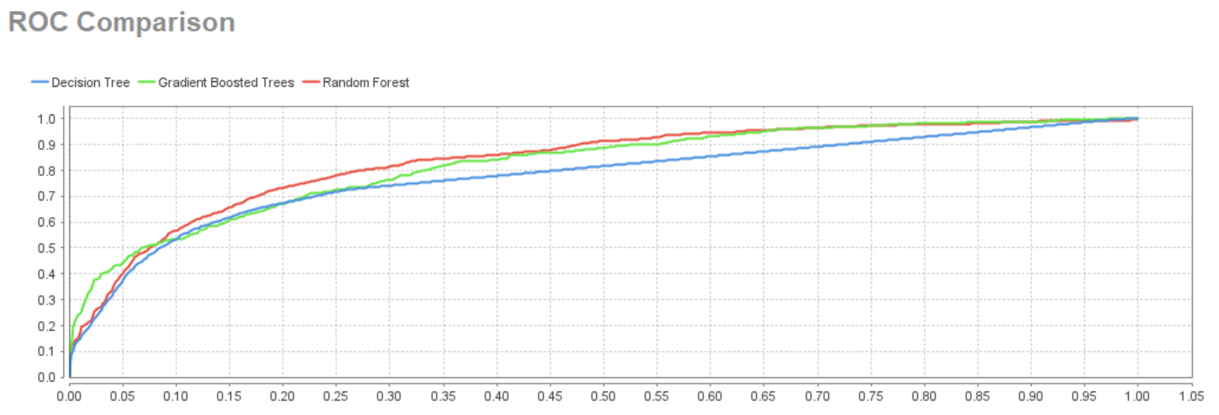
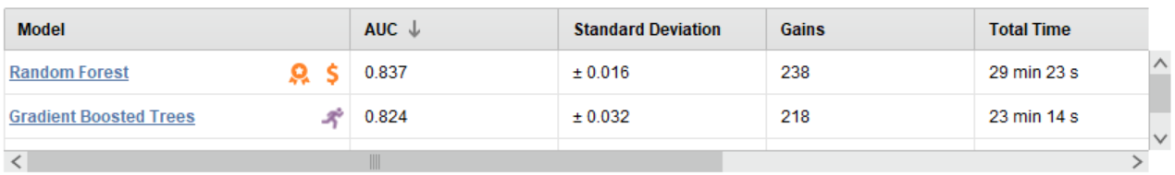
AUC & the ROC Curve
You can see here that
The Random Forest
Model does the best in
overall performance
by AUC.

Slide 23
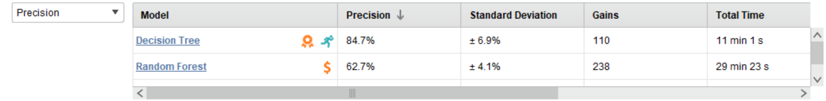
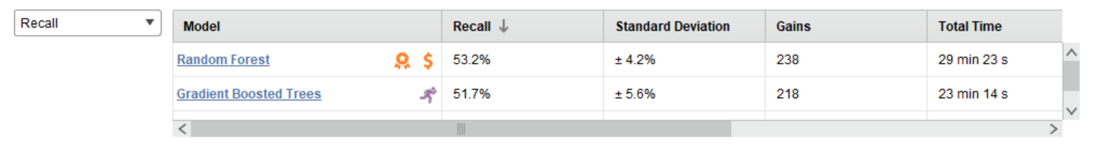
Precision/Recall
As you can see by the above table, the Decision Tree performs very well when it comes to Precision, however,
I’m inclined to ignore this. Decision Trees are known for overfitting training data. Random Forest appears to
balance precision and recall well, while doing better in precision and having the higher AUC.

Slide 24
Feature Engineering - Automated
In the following slide, you’ll see the features that RapidMiner automatically generated. I was taken back by what it decided on. For instance, one of the feature was the log of NumOfProducts. The range of NumOfProducts is 1-4 so the scale doesn’t really call for a log transformation. I’m not sure why the model would perform better transformed. Also, the decision tree type models don’t care about transformations. This is also displayed when taking the square root of age. I’m guessing these are just quirks.
The feature selection/feature generation models didn’t perform really any better than the original features ran in the first auto model iteration. Therefore, I am going to discard these automated features due to added complexity. I decided to try a few of my own as you’ll see next.

Slide 25
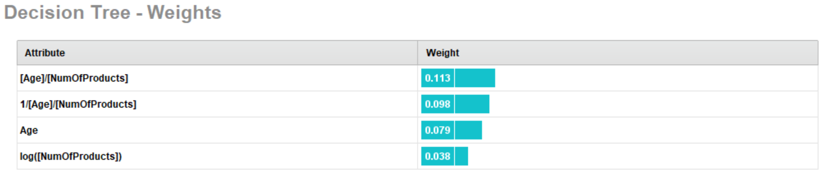
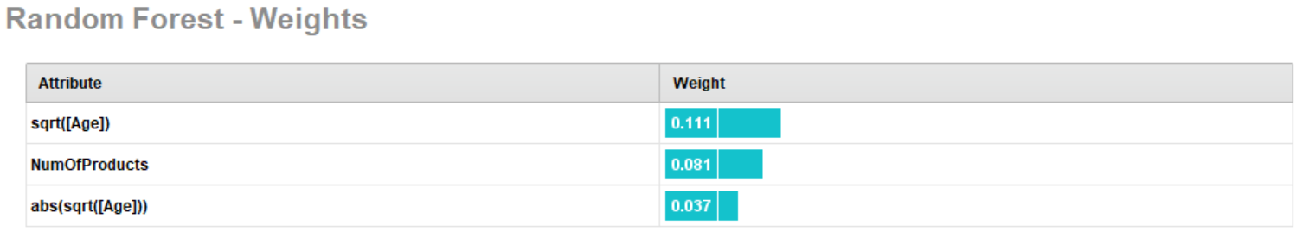
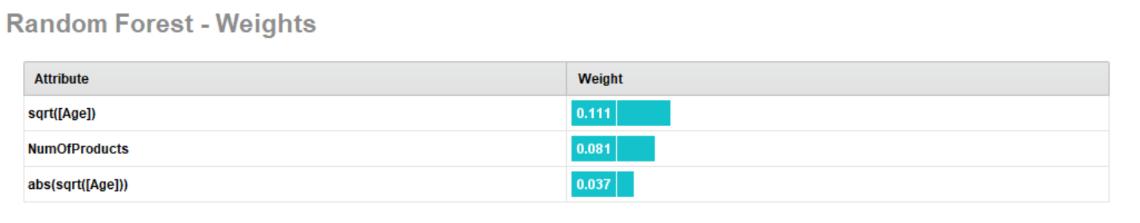
Feature Engineering – Automated (Cont’d)

Slide 26
Feature Engineering - Manual
Since the automated features failed, I decided to create a few of my own, see below:
Age – put into bins ranging in spans of 10 years/
Balance, put into multiple binary fields
Less than 10K
Less than 50K
Less than 100K
Less than 200K

Slide 27
Prototype 3 – Auto Model
The following are the auto model results with my manual feature engineering additions.

Slide 28
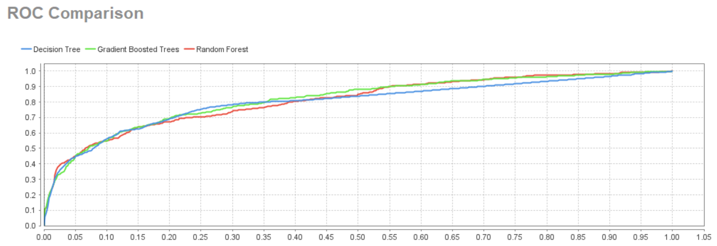
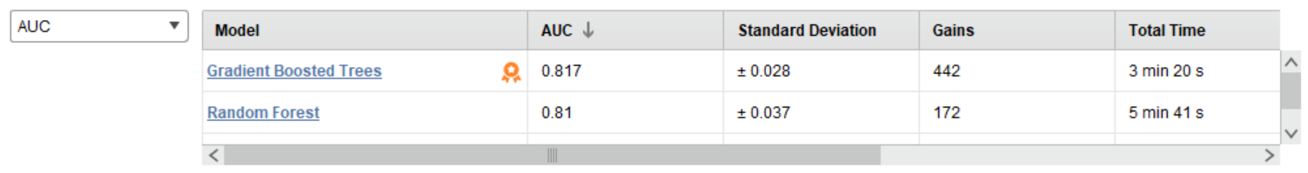
ROC and AUC
Gradient Boosting, in this
Iteration has the highest
AUC, but we have obtained
better results previously.

Slide 29
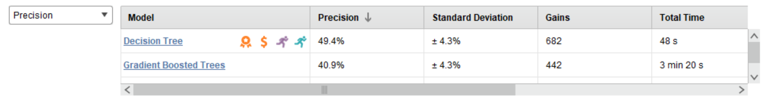
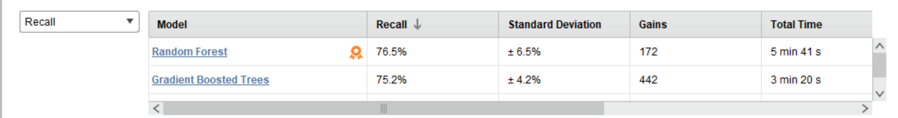
Recall and Precision
Precision is our highest of priorities when it comes to model evaluation and each of these models performed
subpar.

Slide 30
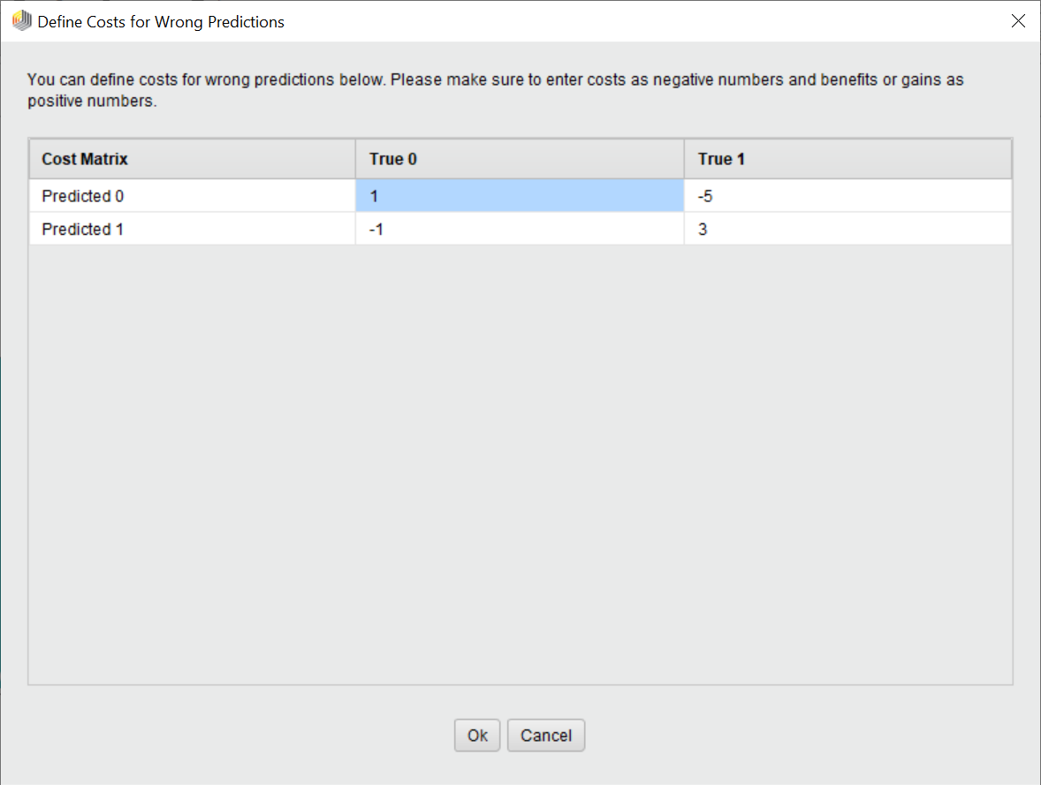
Prototype 4 – Auto Model
For my final attempt of auto modeling for going to the modeling phase, I go back to the data set identified after the data access and understanding phase. Adding in the feature engineered variables both automated and manual did not seem to have a positive effect on the performance of the model.
I assigned a higher benefit to identifying true churners and a higher cost for missing true churners.

Slide 31
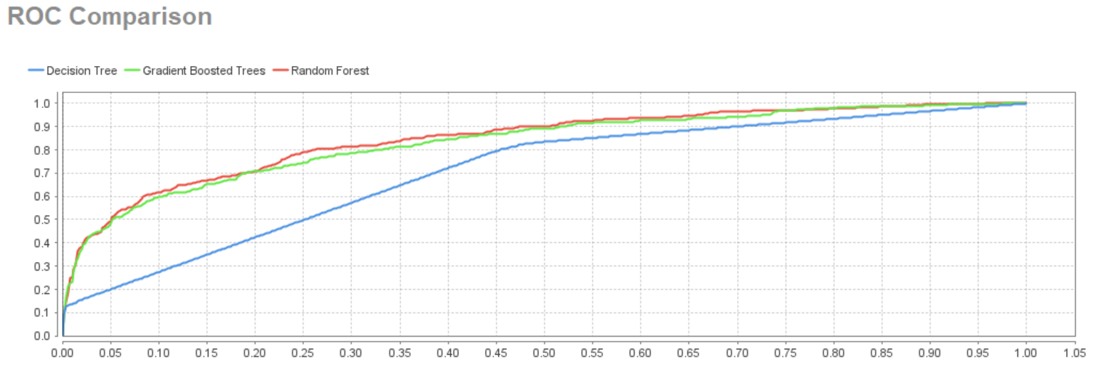
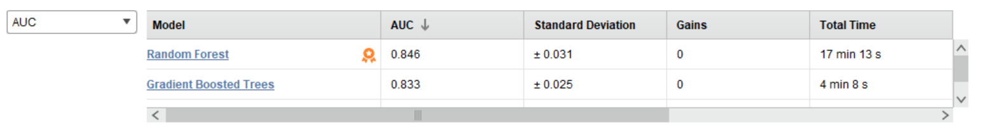
AUC and the ROC Curve
Random Forest has a great
AUC at .846

Slide 32
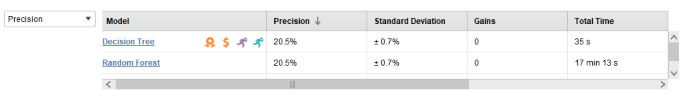
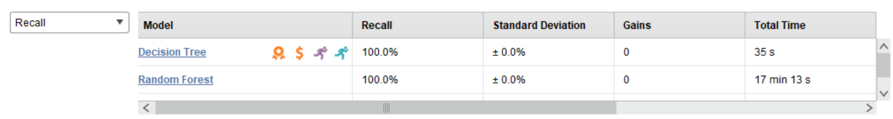
Precision and Recall
Precision is too low here for us to justify going with these groups of models with the data since we were able to get a much higher precision with the automated feature engineered data set.

Slide 33
Modeling

Slide 34
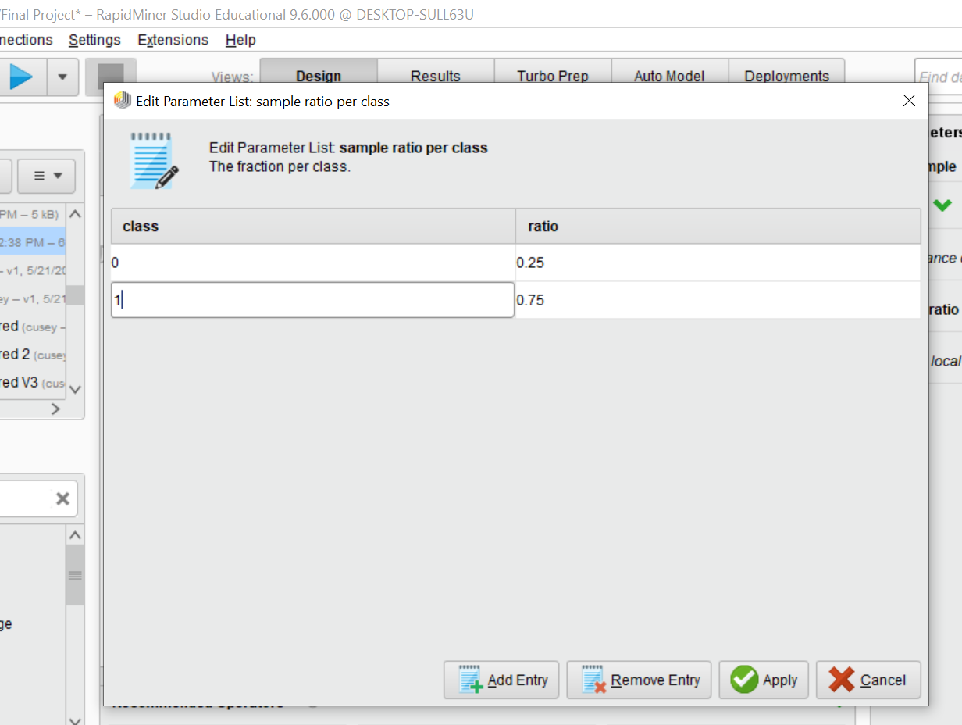
Prototype 5 – Auto Model
In the last iteration of auto model, I balanced the classes better so that the model can learn what makes a customer churn better. This was obtained by using the sample operator:
I In addition, I allowed the Ages to remain binned.
The following slides detail the results.

Slide 35
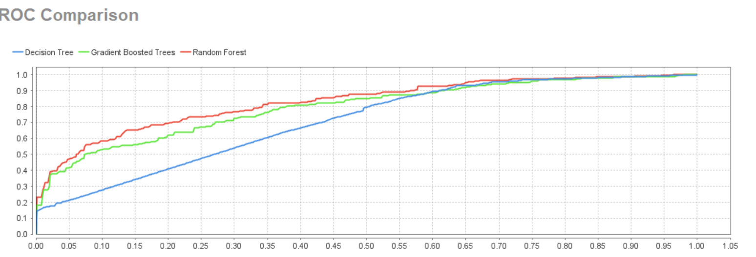
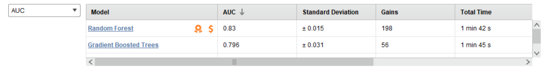
ROC and AUC
Random Forest obtained the best AUC, but each model produced a better AUC then .6

Slide 36
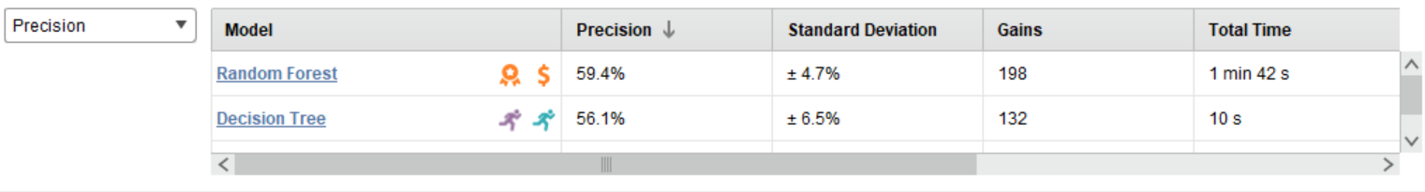
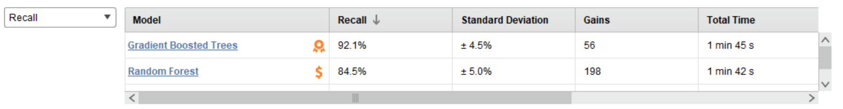
Precision and Recall
Since our priority is to optimize precision and then recall, Random Forest optimizes precision the best
and performs adequately for recall. In addition, it has the highest AUC. As a result, Random Forest
will be the model we move forward with.

Slide 37
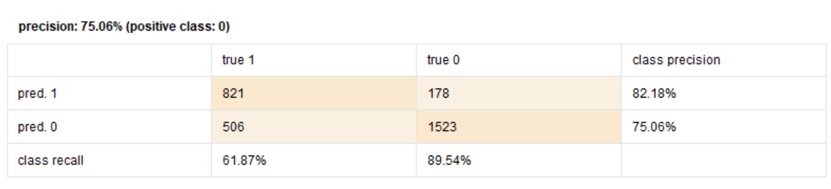
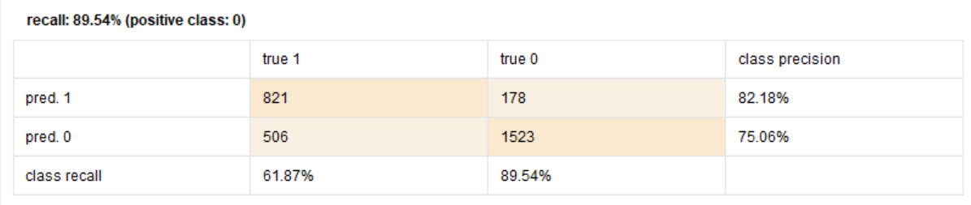
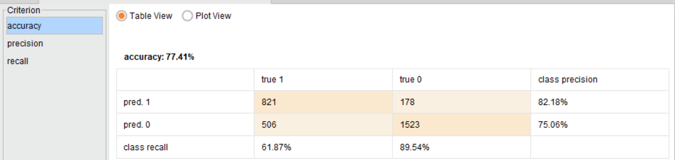
Hyper Parameterize Best Model:
Leaving the defaults on the Random Forest Model maintains the performance found in the auto model
version:

Slide 38
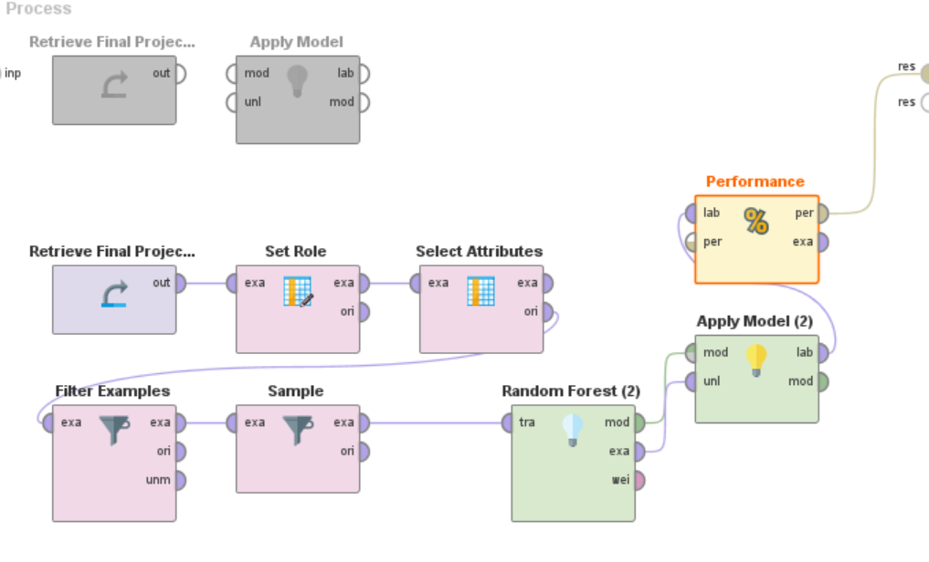
Rapid Miner Process:

Slide 39
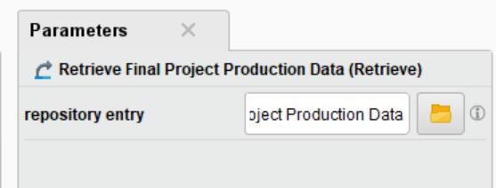
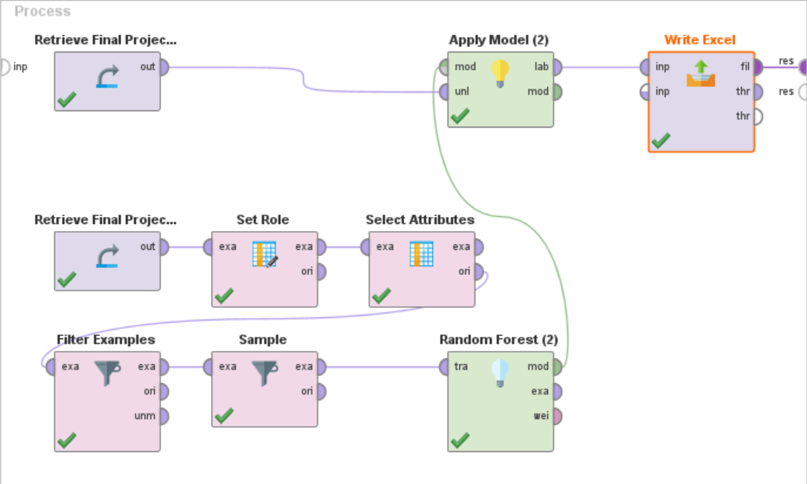
Applying model to the Production Dataset
To the right shows the Random Forest Model applied to the Production Data
The output of this process writes the results to an excel spreadsheet in preparation of identifying the top 100 most likely to churn.

Slide 40
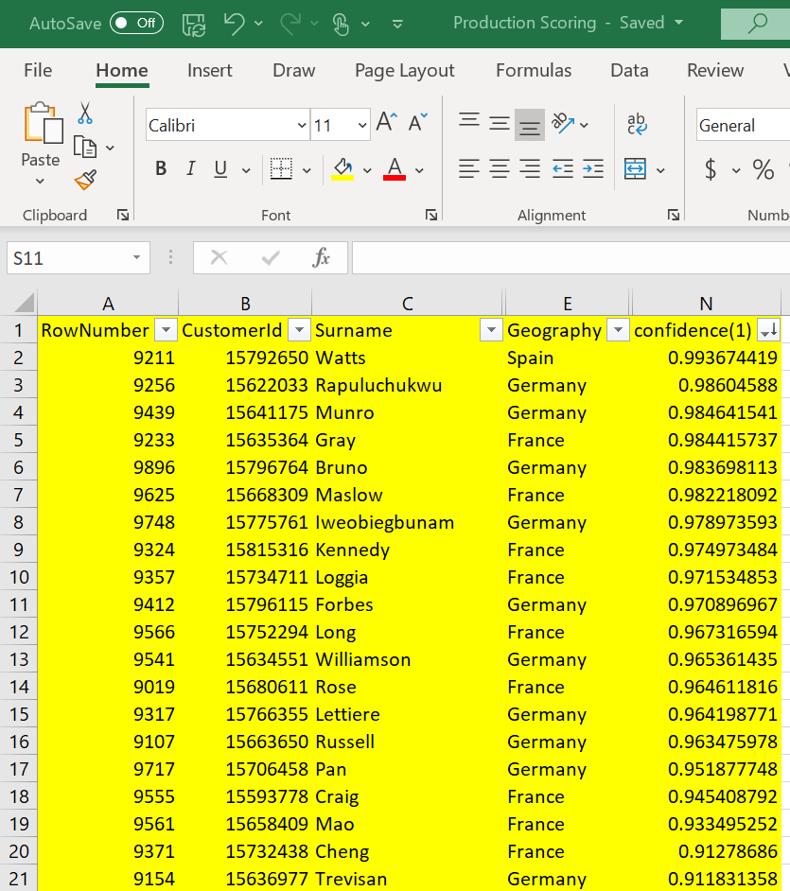
Identify 100 most likely churners
The spreadsheet the process produced, sorted
by the confidence of class 1 descending,
Identifies the top 100 customers that are
most likely to churn.

Slide 41
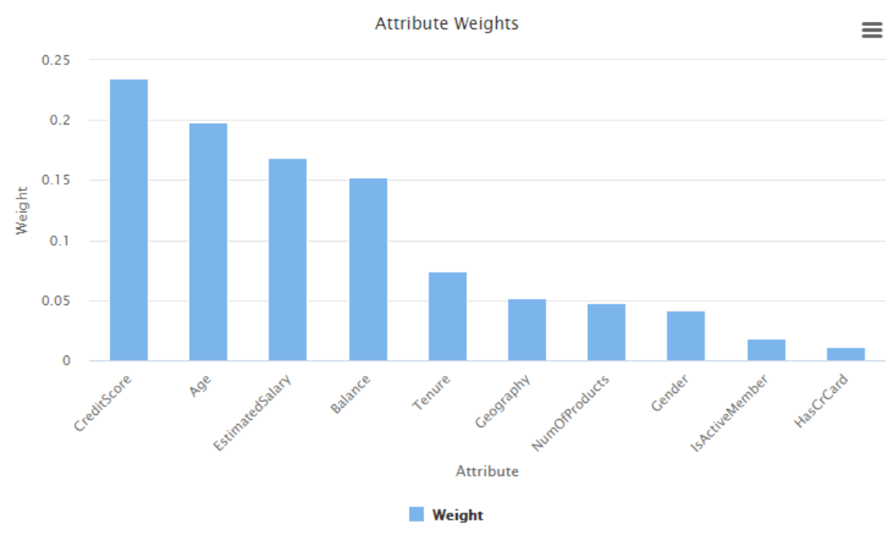
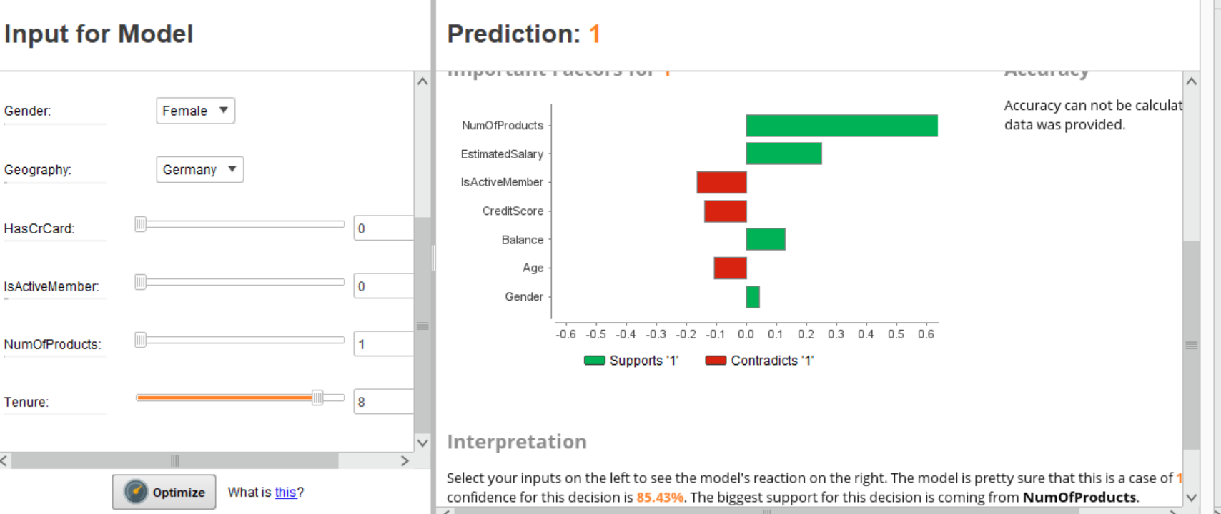
Profile of Churners:
According to the model simulator, Churners have the following characteristics:
A higher number of banking products/accounts
A higher estimated salary
Is more of an active member
Has a higher credit score
Has a higher balance
Is a younger individua l
The above characteristics indicate that these could be people who have a need to finance and open many accounts. These people might be shopping for the best interest rates, regardless of loyalty to a bank. Younger people typically have larger balances due to first time mortgages and student loans.

Slide 42
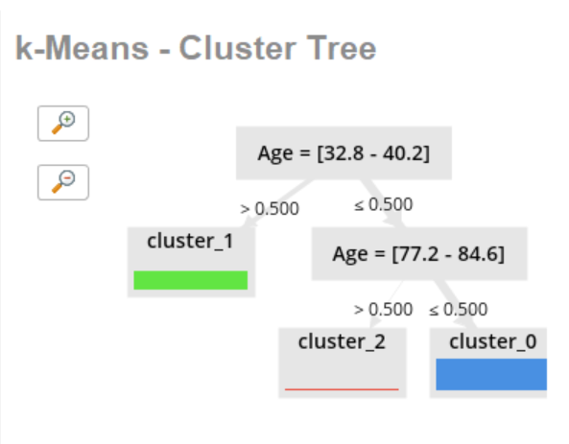
Clusters of Major Market Segments
The K-Means clustering algorithm really focused on age being the main item that separated the data points the most.

Slide 43
Recommended Actions to Bank
MLC Consulting recommends that AWP Bank offers some incentive for customers to have multiple accounts open at their bank. For instance, if somebody is borrowing money for both a house and a car, perhaps offer a lower amount of money required for a down payment OR a half of a percent of lower interest.
Make sure to be competitively priced with nearby banks and competitors.
Offer free educational or consulting services for younger adults getting started in financials. Build a level of trust and loyalty with this segment of the market.
Send advertising on new programs (suggested above) to customers are most likely to churn.
Send follow up surveys on customer satisifcation.

Slide 44
How to deploy the model to each location in Europe
Distribute the production scoring file to all branches of AWP Bank. Teach each branch manager to filter on the Geography column of the excel worksheet. As a result, the managers will be able to follow the recommendations provided for the customers in their specific region.

